Slide 1
The Bunsen Burner

Slide 2
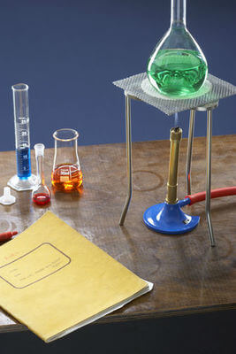
By the end of this Smart Lesson you should be able to:
State what the Bunsen burner is used for.
Name the parts of the Bunsen burner and their function.
Use the Bunsen burner and its flame effectively and safely.

Slide 3
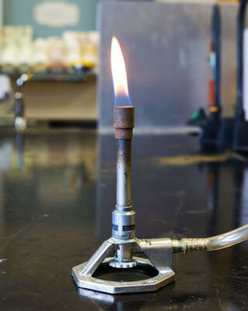
In science we often have to heat substances.
To do this in the lab, we often use Bunsen burners.
A Bunsen burner is a small gas burner designed to heat small amounts of substances. In case you are wondering, it is named after the German chemist, Robert Bunsen.

Slide 4
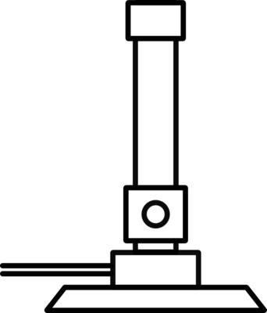
The following image is the scientific symbol, or drawing, for a Bunsen burner.
Drawing a detailed Bunsen burner may be too time consuming or difficult, so we use easy symbols when we draw diagrams.

Slide 5
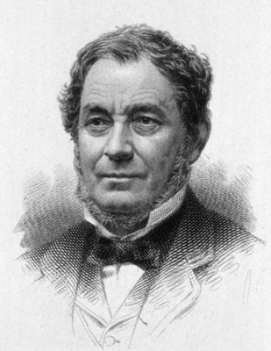
Where did the Bunsen burner come from?
It all started with Robert Bunsen, who was a German chemist born in 1811.
He was a bit of a genius, as he made countless different discoveries in his years as a scientist. However, what he is perhaps most remembered for is inventing the Bunsen burner!
Interestingly, he never actually built a Bunsen burner, but he did think up the idea. Once the Bunsen burner was built in the mid-1800s, it became a vital piece of equipment for laboratories all over the world.

Slide 6
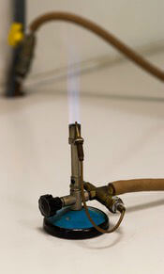
Always be careful when using a Bunsen burner.
They produce an open flame and burn at a high temperature. As a result, there is potential for an accident to occur.
Never leave a Bunsen burner alight and unattended.

Slide 7
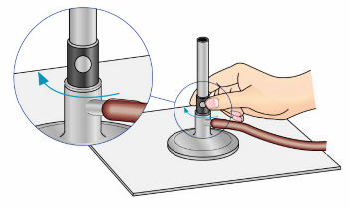
To light the Bunsen burner safely follow the steps listed below:
1. Connect the hose of the Bunsen burner to the gas tap.
2. Close the air hole by turning the collar.
3. Light the match and hold it above the top of the barrel.
4. Turn on the gas.

Slide 8
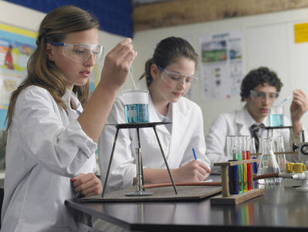
When it comes to lighting a Bunsen burner, it is always safety first.
Before you get started, make sure you are wearing the appropriate laboratory safety equipment. This means that your safety glasses should be on, and your hair should be tied back if its long enough!
Before you light your Bunsen burner, always double check that the air hole is closed. This way, when the Bunsen burner is lit, it will show the yellow “safety flame”. We will learn more about this flame in the next section.

Slide 9
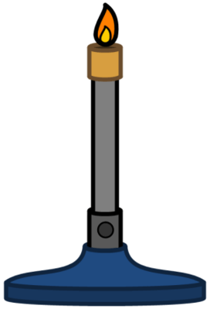
You can control the temperature of the burner by turning the collar and opening and closing the air hole.
When the air hole is open, there is more oxygen, so the flame is hotter.
The yellow flame is the 'safety flame.' It can be seen easily and is present when the air hole is closed. The yellow flame is dirty, as it contains soot that can cause glassware to go black.

Slide 10
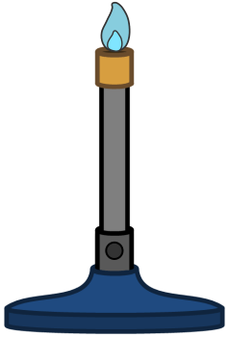
When we open the air hole the flame turns blue.
The blue flame (air hole open) is used for fast heating. This is the hottest flame. It can be dangerous because sometimes it is almost invisible when in a light room.

